Slide 1

Digital Lost & Found System
MADE BY:
AKASH SIVANANDAN
Soumen Kumar
Dhananjay
Girish KHANNA

Slide 2
INTRODUCTION & PROBLEM
Introduction
Manual lost & found systems are inefficient
No centralized record management
Difficult to search lost items
Solution
Online platform for reporting and searching items
Cloud-based real-time data storage

Slide 3
Project Objectives
Secure user registration and login
Allow users to report lost and found items
Store data in cloud database
Display real-time reports
Provide user-friendly interface

Slide 4

Frontend: HTML, CSS, JavaScript Backend: Firebase Authentication Firebase Firestore Database Deployment: GitHub Pages
Technologies Used

Slide 5
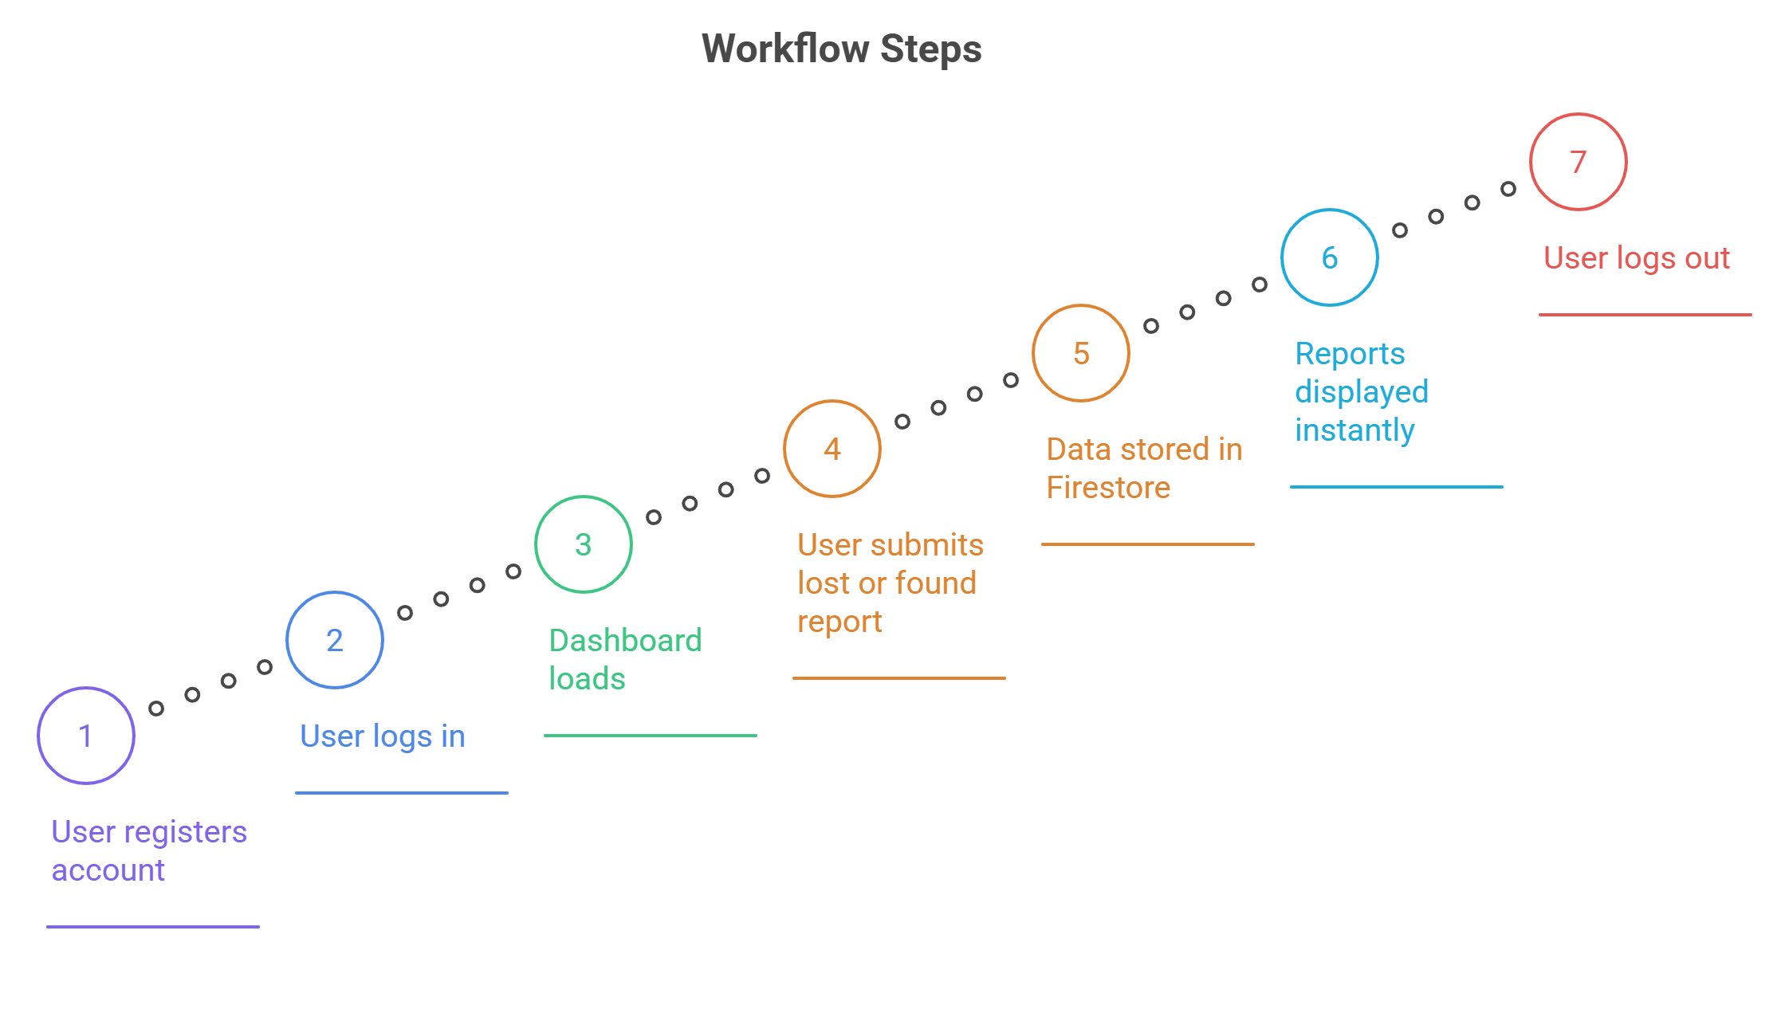
Workflow

Slide 6
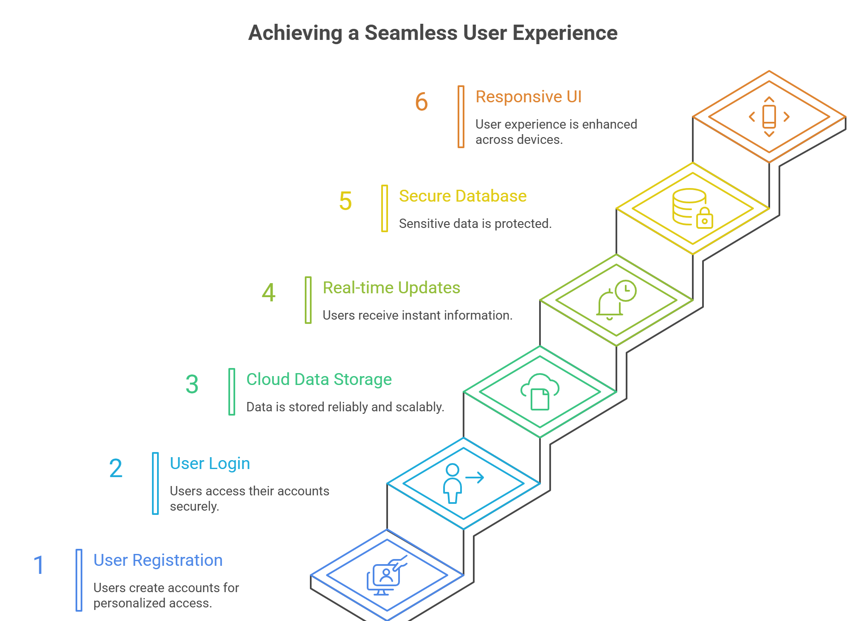
FEATURES

Slide 7

Conclusion
Provides efficient digital solution
Reduces manual effort
Improves accessibility
Improves accessibility

